Slide 1
So What Do We Need To Do?
Find a Useful Theory of Networking
As opposed to ad-hoc approaches
Again, consider the success of convolutional neural networks
What is the “interlingua” for networking?
Public Data Sets
Skill Sets
But watch out
https://papers.nips.cc/paper/5656-hidden-technical-debt-in-machine-learning-systems.pdf
Apply state of the art machine learning algorithms
Build ML platforms and associated automation
Explainable end-to-end systems
Learn control not just prediction

Slide 2
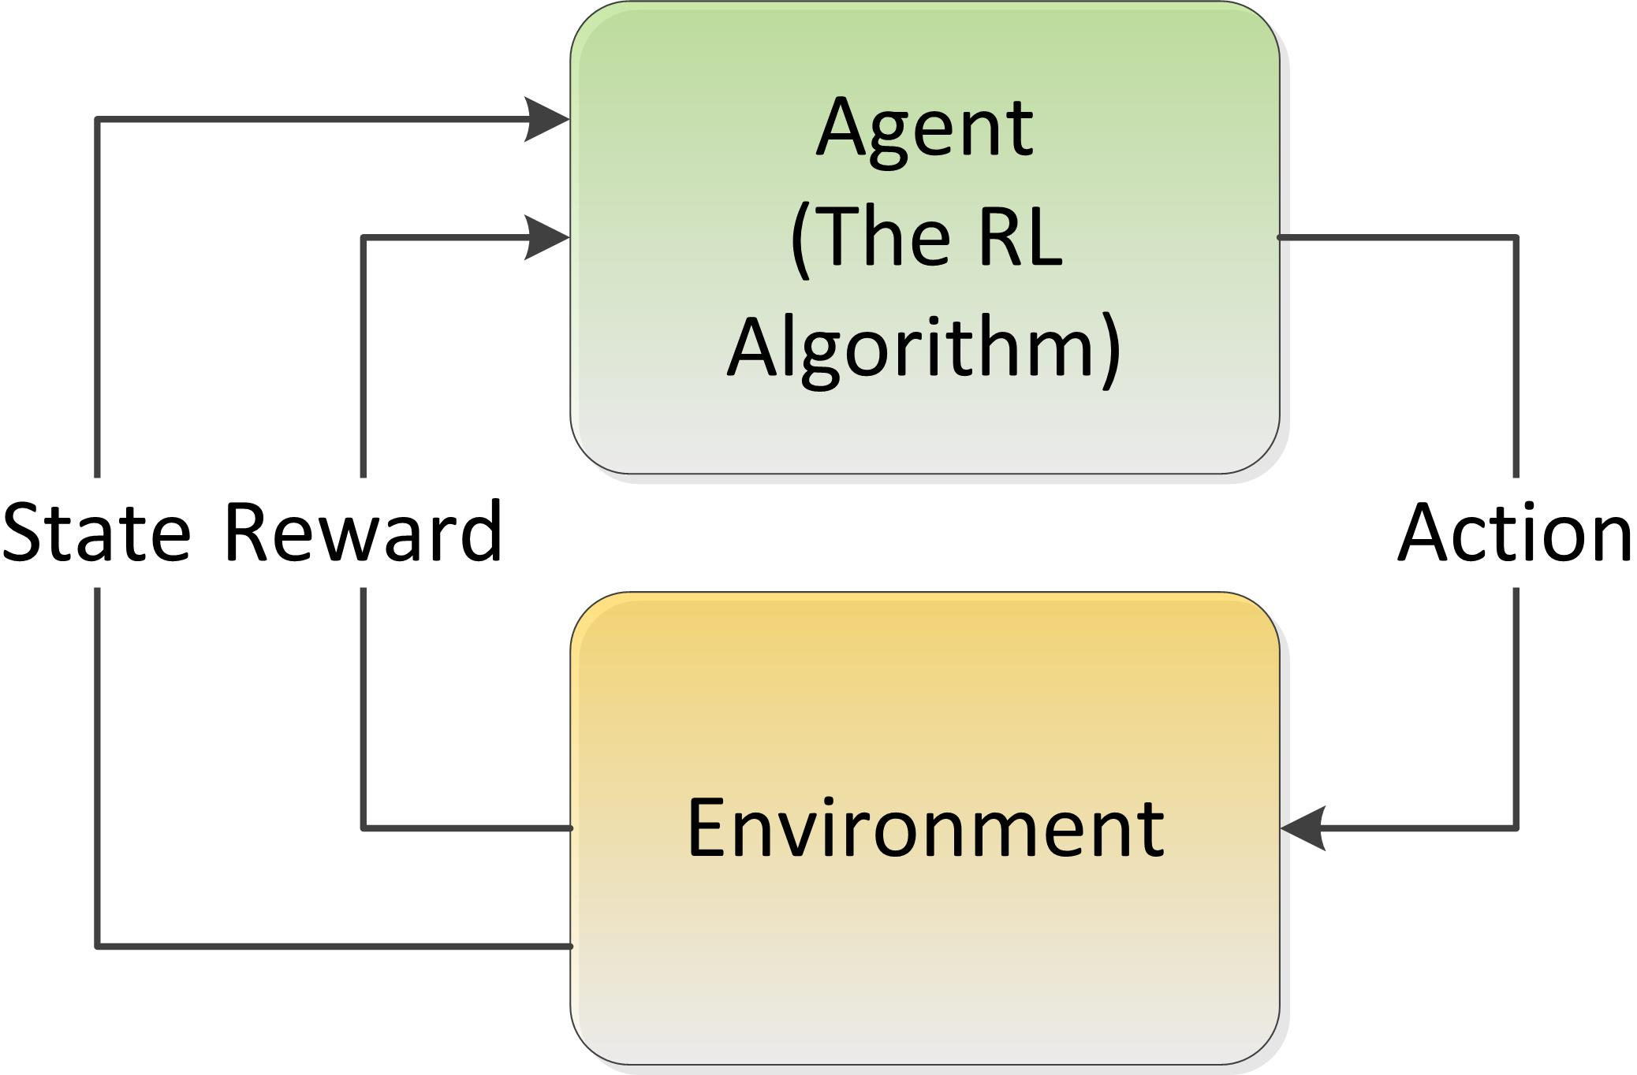
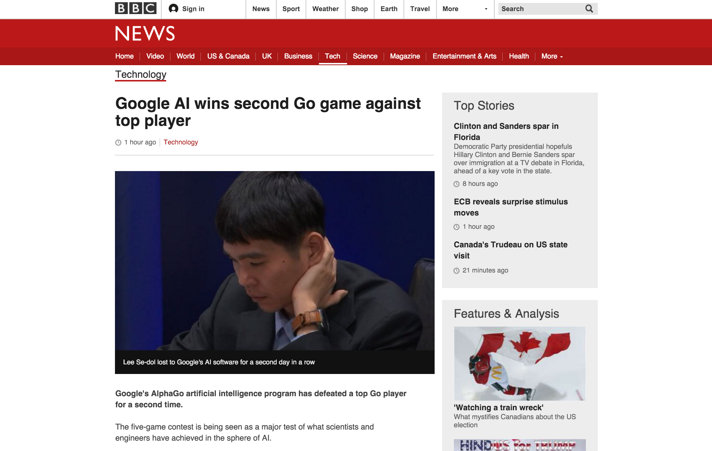
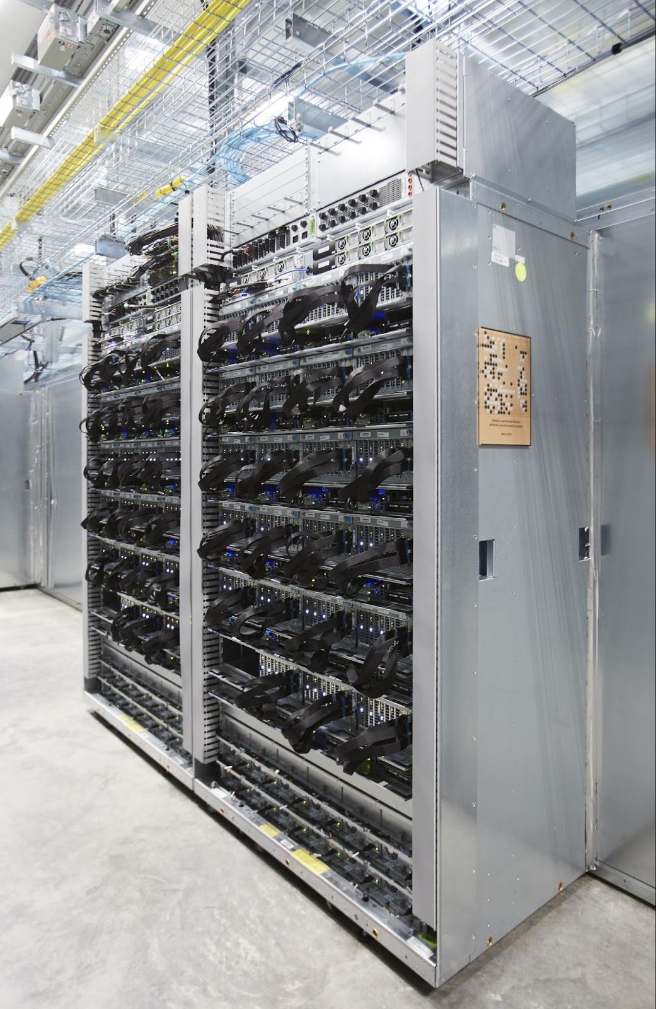
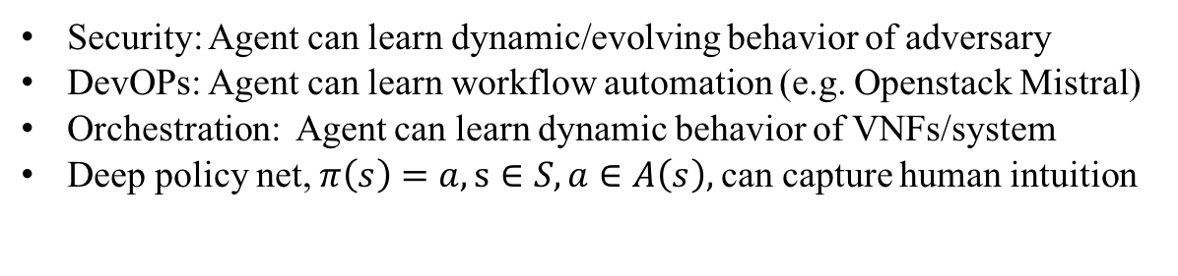
Learning Control? Reinforcement Learning Meets Monte Carlo Tree Search and Deep Learning
Hard coded control logic (not learned)
Security: Agent can learn dynamic/evolving behavior of adversary
DevOPs: Agent can learn workflow automation (e.g. Openstack Mistral)
Orchestration: Agent can learn dynamic behavior of VNFs/system
Deep policy net, $π\left(s\right)=a, s∈S, a∈A\left(s\right),$can capture human intuition
http://www.nature.com/nature/journal/v529/n7587/full/nature16961.html

Slide 3
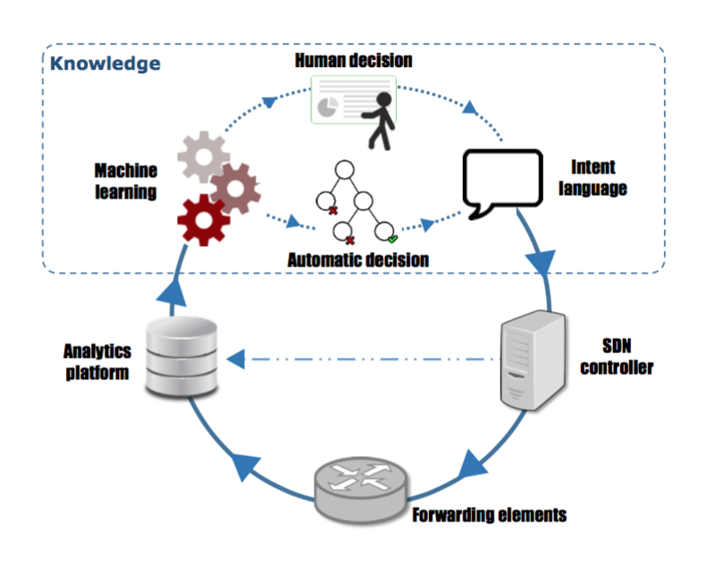
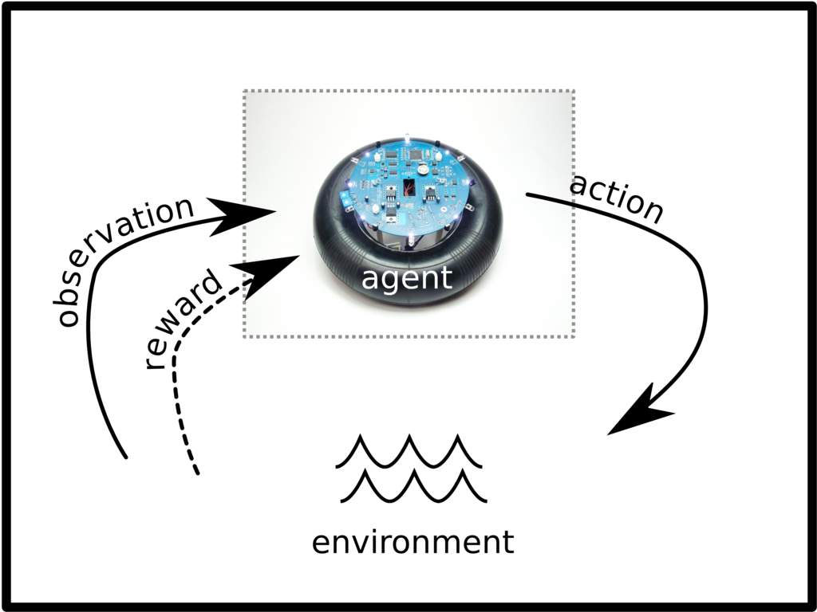
Static vs. Reinforcement Learning Architectures
Today’s Static ML Architectures
ML doesn’t have “agency”
Hard-coded or open loop control
Learns prediction
Doesn’t learn control
Assumes stationary DGD
Largely off-line
Reinforcement Learning Architecture
Agent architecture
Agent learns control/action selection
Adapts to evolving environment
Non-stationary distributions
Network gamification

Slide 4
Summary
Lots of Network Data
Standardized and labeled datasets still scarce
However, most network data sources (e.g., netflow) not designed for ML
Arbitrary data might be over-valued
Lots of open source ML frameworks, Cloud APIs, Examples, …
Google -- Tensorflow (tensorflow.org)
Facebook -- Torch (torch.ch)
Microsoft -- CNTK (https://github.com/Microsoft/CNTK)
Amazon -- MXNET (https://aws.amazon.com/mxnet)
Other popular frameworks
Keras (https://keras.io/)
Theano (https://github.com/Theano)
…
However, networking industry still dominated by MLwashing, platforms, clustering, …
Skills gap persists and it still requires skill/experience to
Build DNN architectures/models
Find ”good” settings for hyper-parameters
Prevent overfitting
But again, be careful: SOTA LSTMs+RLs are starting to be able to build neural networks
https://openreview.net/pdf?id=r1Ue8Hcxg, http://papers.nips.cc/paper/6461-learning-to-learn-by-gradient-descent-by-gradient-descent.pdf, …
…
All of this said, you will be seeing ML in all facets of networking
And everything else for that matter

Slide 5
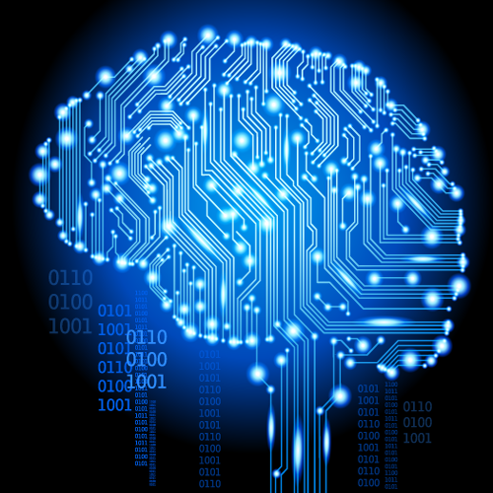
So Call To Action Where Do We Need To Focus?
Find a Useful Theory of Networking
As opposed to ad-hoc approaches
Again, consider the success of convolutional neural networks
What is the “interlingua” for networking?
Public Data Sets
Skill Sets
State of the art machine learning algorithms
ML platforms and associated automation
Explainable end-to-end systems
Learn control not just prediction
Reinforcement Learning
Evolution Strategies (https://blog.openai.com/evolution-strategies)
Others?

Slide 6
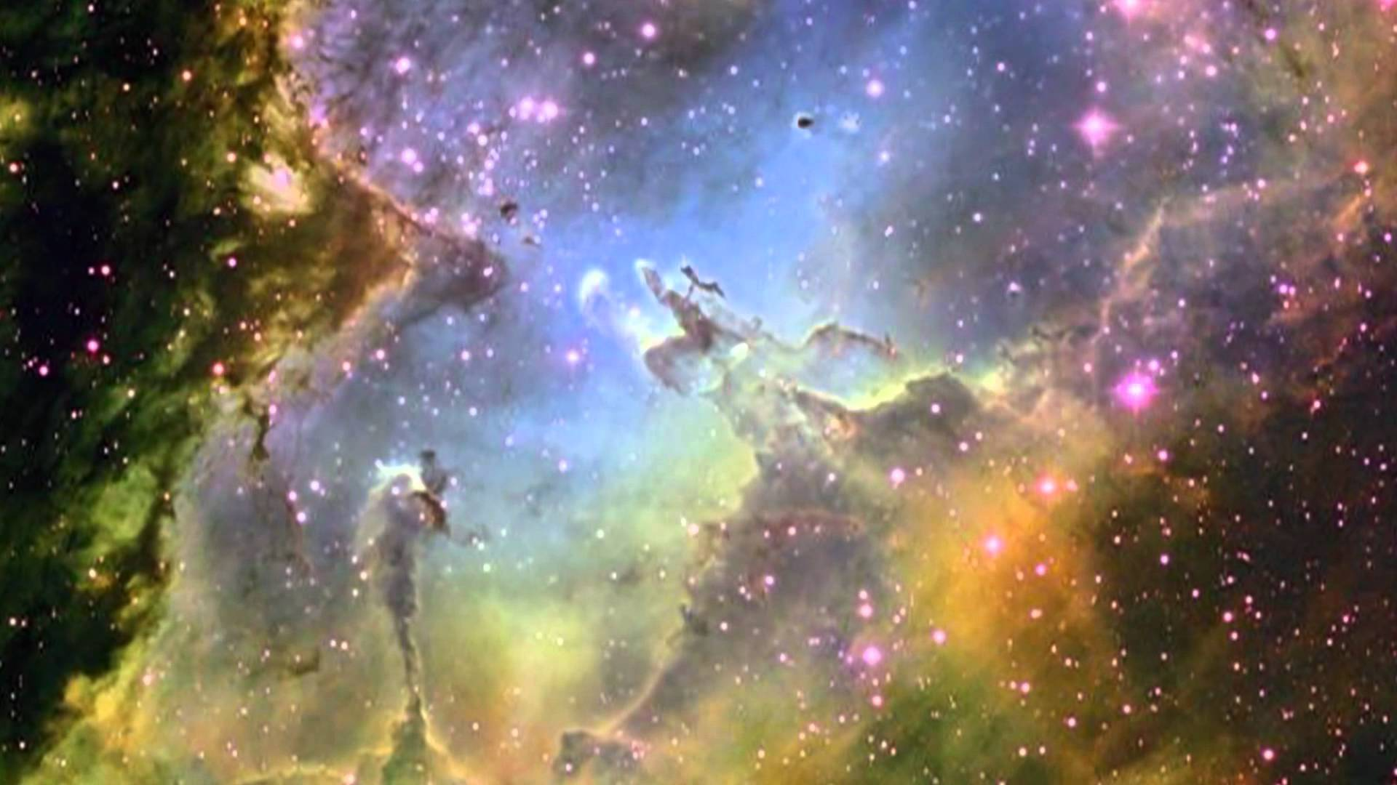
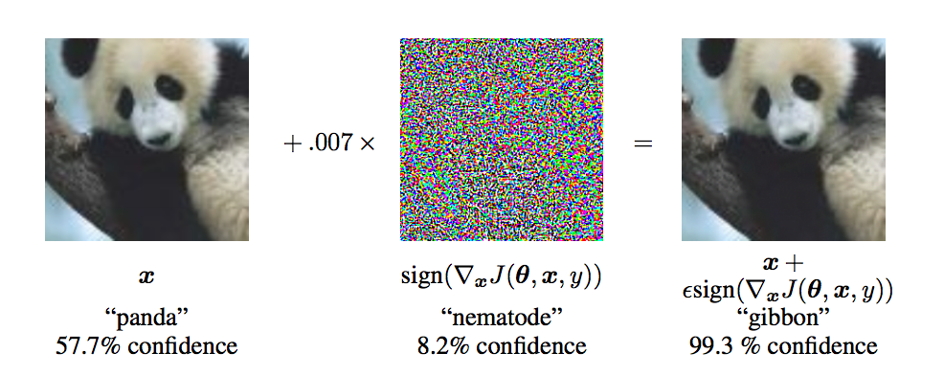
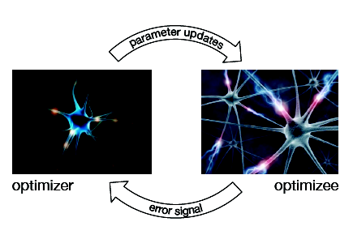
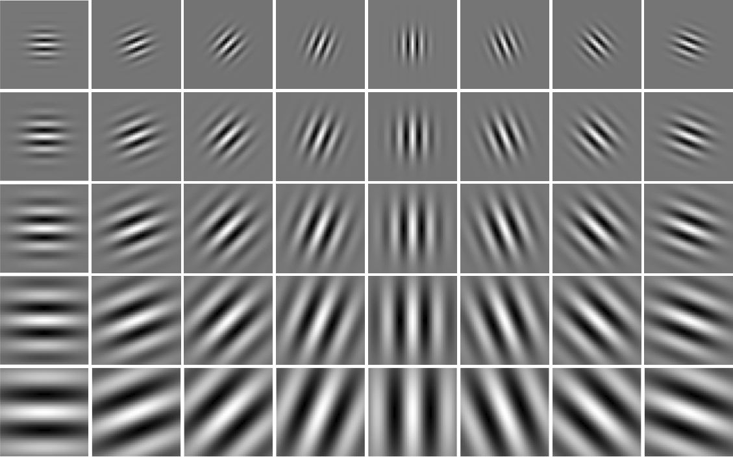
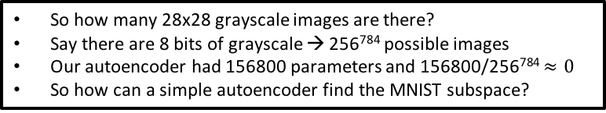
Finally…Many Beautiful Mysteries Remain
Back-propagation
Gradient-based optimization/back-propagation
Why is such a simple algorithm so powerful?
New optimizer/optimizee paradigms
AlphaGo
https://deepmind.com/research/alphago
Adversarial Images/Generative Adversarial Nets (GANs)
https://arxiv.org/abs/1412.6572
Learning to learn by gradient descent by gradient descent
https://arxiv.org/abs/1606.04474
Neural Architecture Search With Reinforcement Learning
https://openreview.net/pdf?id=r1Ue8Hcxg
Neural Nets
What are the units (artificial neurons) actually doing?
https://arxiv.org/pdf/1509.06321.pdf
Why does deep and cheap learning work so well?
Physics perspective
http://arxiv.org/pdf/1608.08225v1.pdf
So how many 28x28 grayscale images are there?
Say there are 8 bits of grayscale → 256⁷⁸⁴ possible images
Our autoencoder had 156800 parameters and 156800/256⁷⁸⁴ $≈0$
So how can a simple autoencoder find the MNIST subspace?

